Slide 1

Capstone Project
Bike Sharing Demand Prediction

Slide 2
Problem Statement
Currently Rental bikes are introduced in many urban cities for the enhancement of mobility comfort. It is important to make the rental bike available and accessible to the public at the right time as it lessens the waiting time. Eventually, providing the city with a stable supply of rental bikes becomes a major concern. The crucial part is the prediction of bike count required at each hour for the stable supply of rental bikes.

Slide 3
Content
Data Pipeline
Data Description
Exploratory Data Analysis
Models performed
Model Validation & Selection
Evaluation Matrix of All the models
Model Explainability - SHAP
Challenges
Conclusion

Slide 4
MetaData : Seoul Bike.csv
Data columns (total 14 columns):
# Column Non-Null Count Dtype
--- ------ ----------- --- -----
0 Date 8760 non-null object
1 Rented Bike Count 8760 non-null int64
2 Hour 8760 non-null int64
3 Temperature(°C) 8760 non-null float64
4 Humidity(%) 8760 non-null int64
5 Wind speed (m/s) 8760 non-null float64
6 Visibility (10m) 8760 non-null int64
7 Dew point temperature(°C) 8760 non-null float64
8 Solar Radiation (MJ/m2) 8760 non-null float64
9 Rainfall(mm) 8760 non-null float64
10 Snowfall (cm) 8760 non-null float64
11 Seasons 8760 non-null object
12 Holiday 8760 non-null object
13 Functioning Day 8760 non-null object
dtypes: float64(6), int64(4), object(4)
memory usage: 958.2+ KB

Slide 5
Data Pipeline
Exploratory Data Analysis (EDA): In this part we have done some EDA on the features to see the trend.
Data Processing: In this part we went through each attributes and encoded the categorical features.
Model Creation: Finally in this part we created the various models. These various models are being analysed and we tried to study various models so as to get the best performing model for our project.

Slide 6
Data Description
Dependent variable:
Rented Bike count - Count of bikes rented at each hour
Independent variables:
Date : year-month-day
Hour - Hour of he day
Temperature-Temperature in Celsius
Humidity - %
Windspeed - m/s
Visibility - 10 m
Dew point temperature - Celsius
Solar radiation - MJ/m2
Rainfall - mm
Snowfall - cm
Seasons - Winter, Spring, Summer, Autumn
Holiday - Holiday/No holiday
Functional Day - NoFunc(Non Functional Hours), Fun(Functional hours)

Slide 7
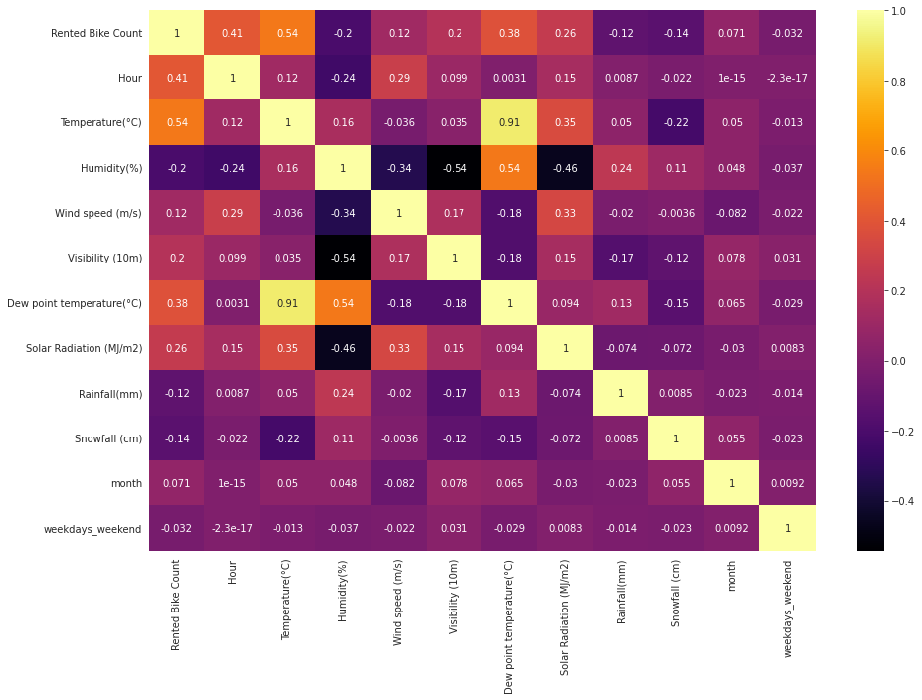
EDA - Feature Correlation
Correlation Graph

Slide 8
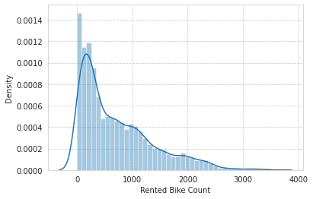
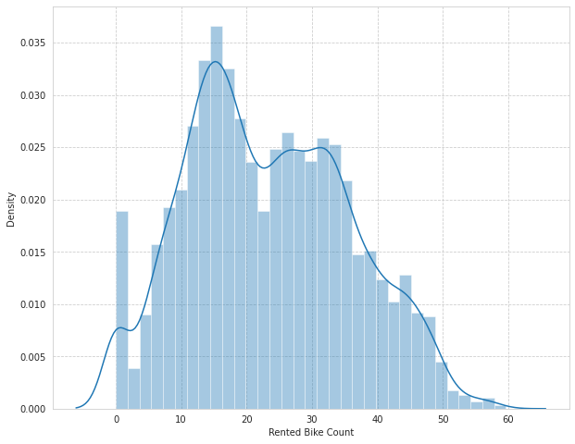
EDA (contd...)
Distribution of rented bike count
Square root transformation of rented bike count

Slide 9
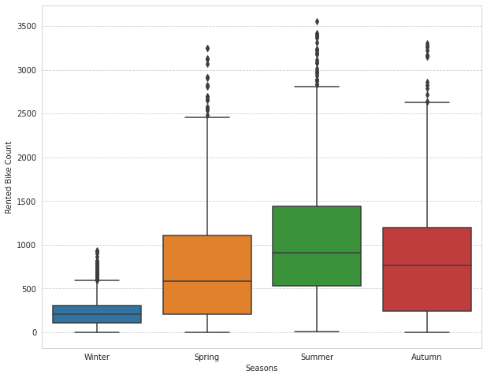
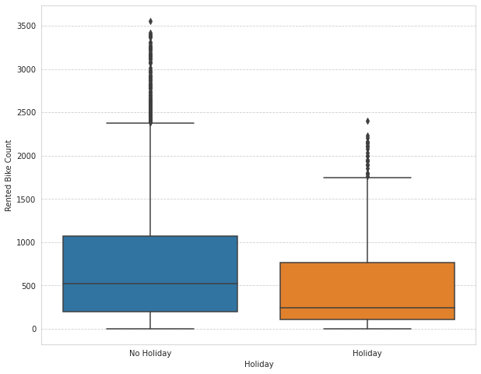
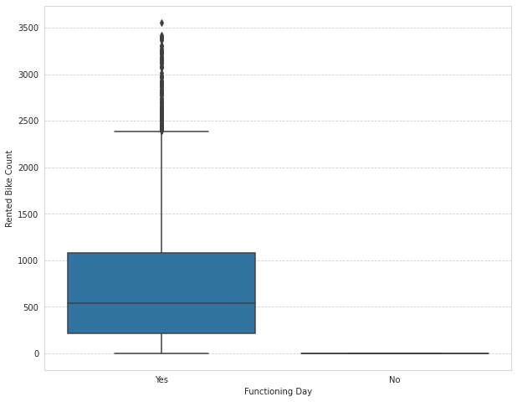
EDA (contd...)
Less demand on winter seasons
Slightly Higher demand during Non holidays
Almost no demand on non functioning day

Slide 10
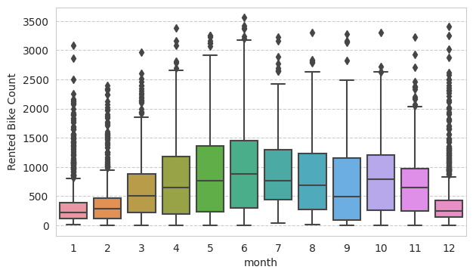
EDA (contd...)
We can see that there less demand of Rented bike in the month of December, January, February i.e. during winter seasons
Also demand of bike is maximum during May, June, July i.e Summer seasons

Slide 11
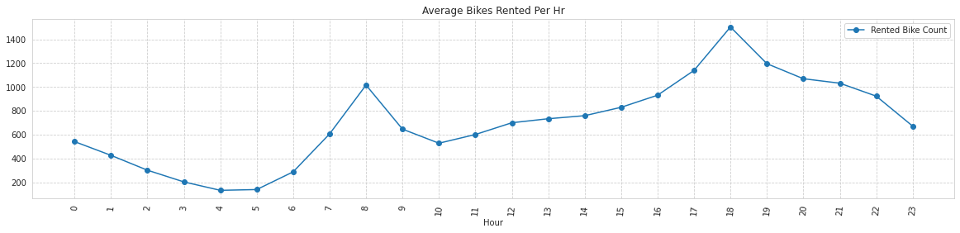
EDA (contd...)
Notes:
We can visualize high rise of Rented Bikes from 8:00 a.m. to 9:00 p.m. which means people prefer rented bike during rush hour.
It can be inferred that demand is at peak at 8 a.m. and 6:00 p.m. Therefore we can say that that during office opening and closing time there is high surge demand for rented bikes.

Slide 12
Model’s Performed
Linear Regression with regularizations
Polynomial Regression
K nearest neighbours
Decision tree
Random forest
Gradient Boost
eXtreme Gradient Boost
lightGBM
CatBoost

Slide 13
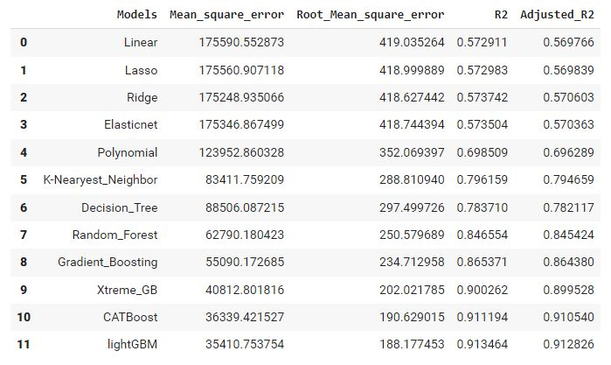
Model’s Evaluation Matrices

Slide 14
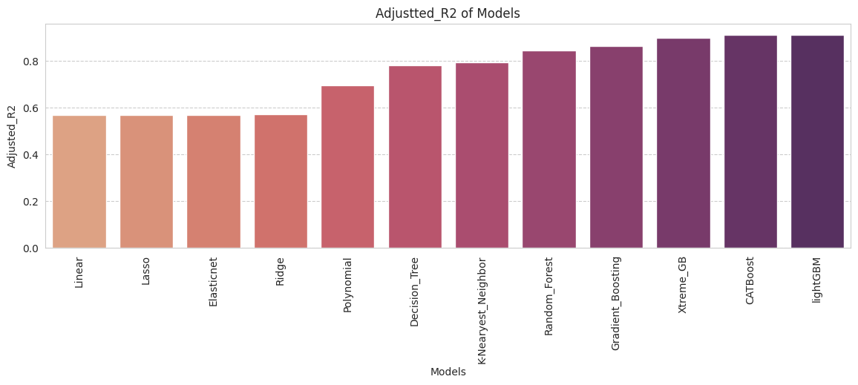
Adjusted R2 of Model’s Performed

Slide 15

Model Validation & Selection(continued)
Observation 1: As seen in the Model Evaluation Matrices table, Linear Regression, KNN is not giving great results.
Observation 2: Random forest & GBR have performed equally good in terms of adjusted r2.
Observation 3: We are getting the best results from LightGBM and CatBoost.

Slide 16
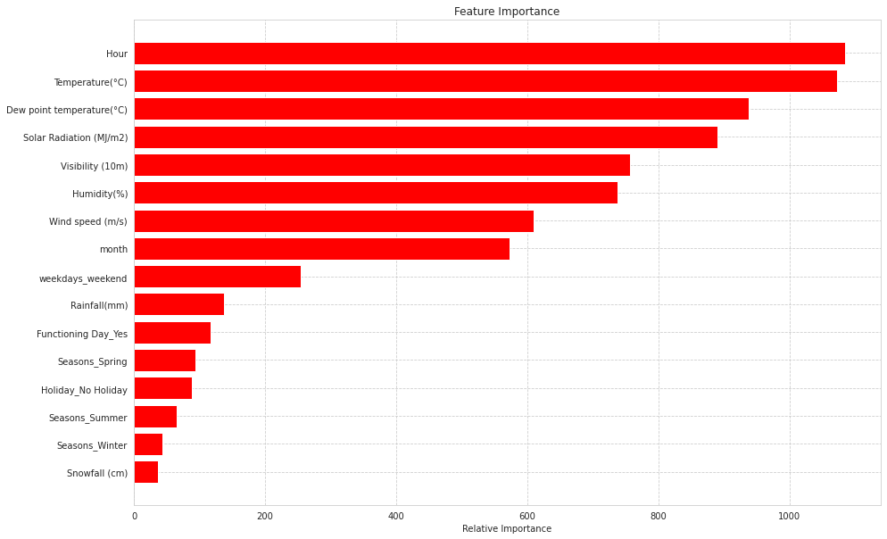
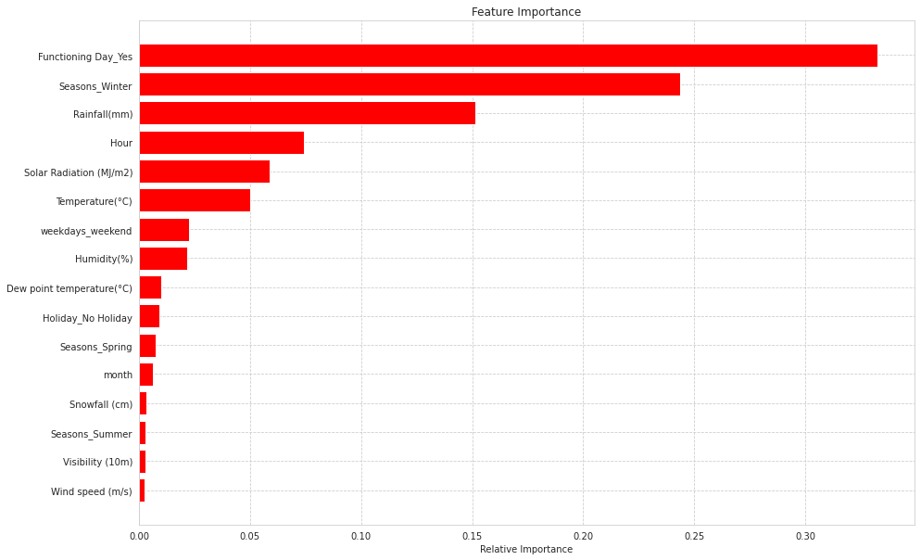
Feature Importance
LightGBM
CatBoost

Slide 17
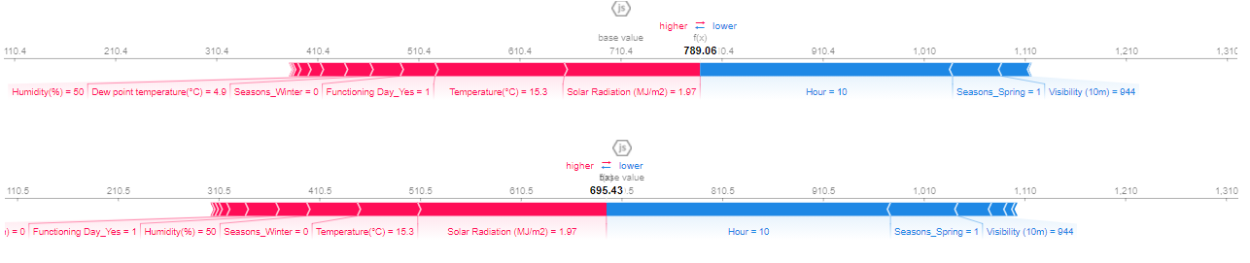
Model Explainability - SHAP
lightGBM
CatBoost

Slide 18

Challenges
A huge amount of data needed to be dealt while doing the project which is quite an important task and also even small inferences need to be kept in mind.
As dataset was quite big enough which led more computation time.

Slide 19

Conclusion
It is quite evident from the results that lightGBM and Catboost is the best model that can be used for the Bike Sharing Demand Prediction since the performance metrics (mse,rmse) shows lower and (r2,adjusted_r2) show a higher value for the lightGBM and Catboost models.
So, we can use either LightGBM or Catboost model for the above problem

Slide 20
THANK
YOU

